Slide 1
Importance of Citizen Participation
International Forum: Democracy and Elections
27-AUG-2018
Sami Hourani M.D. MA
CEO/Founder, Leaders of Tomorrow, FOR9A.COM

Slide 2


Slide 3


Slide 4
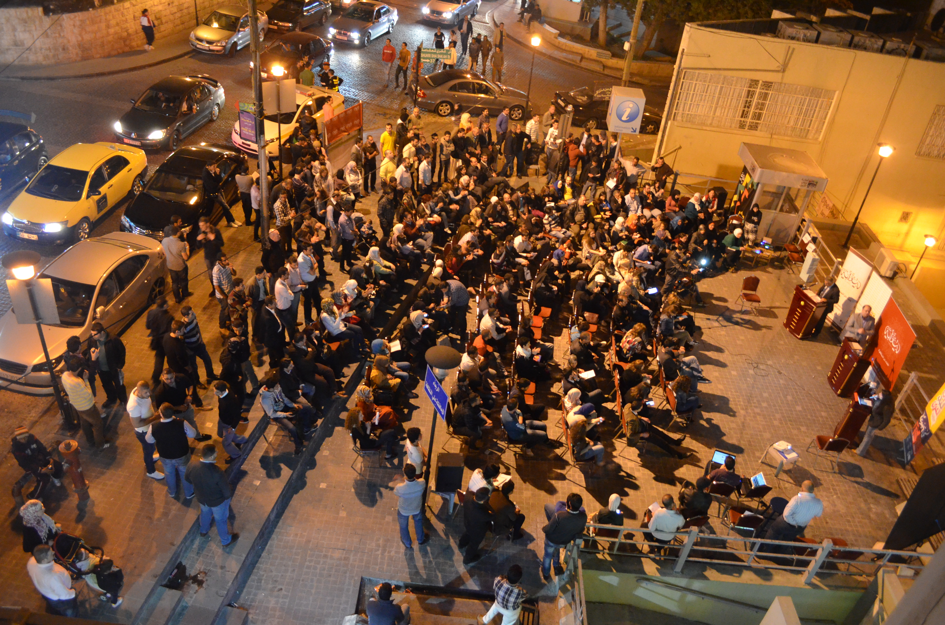
www.diwanieh.com

Slide 5
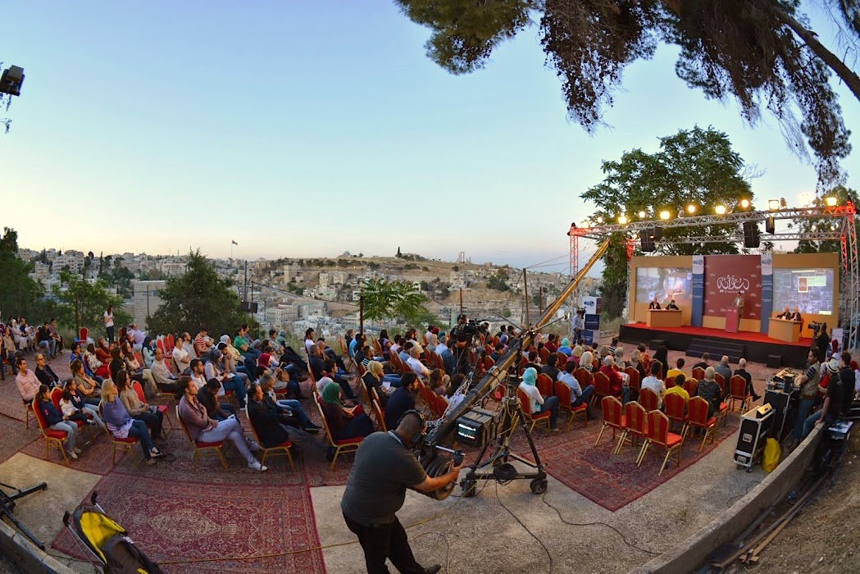

Slide 6
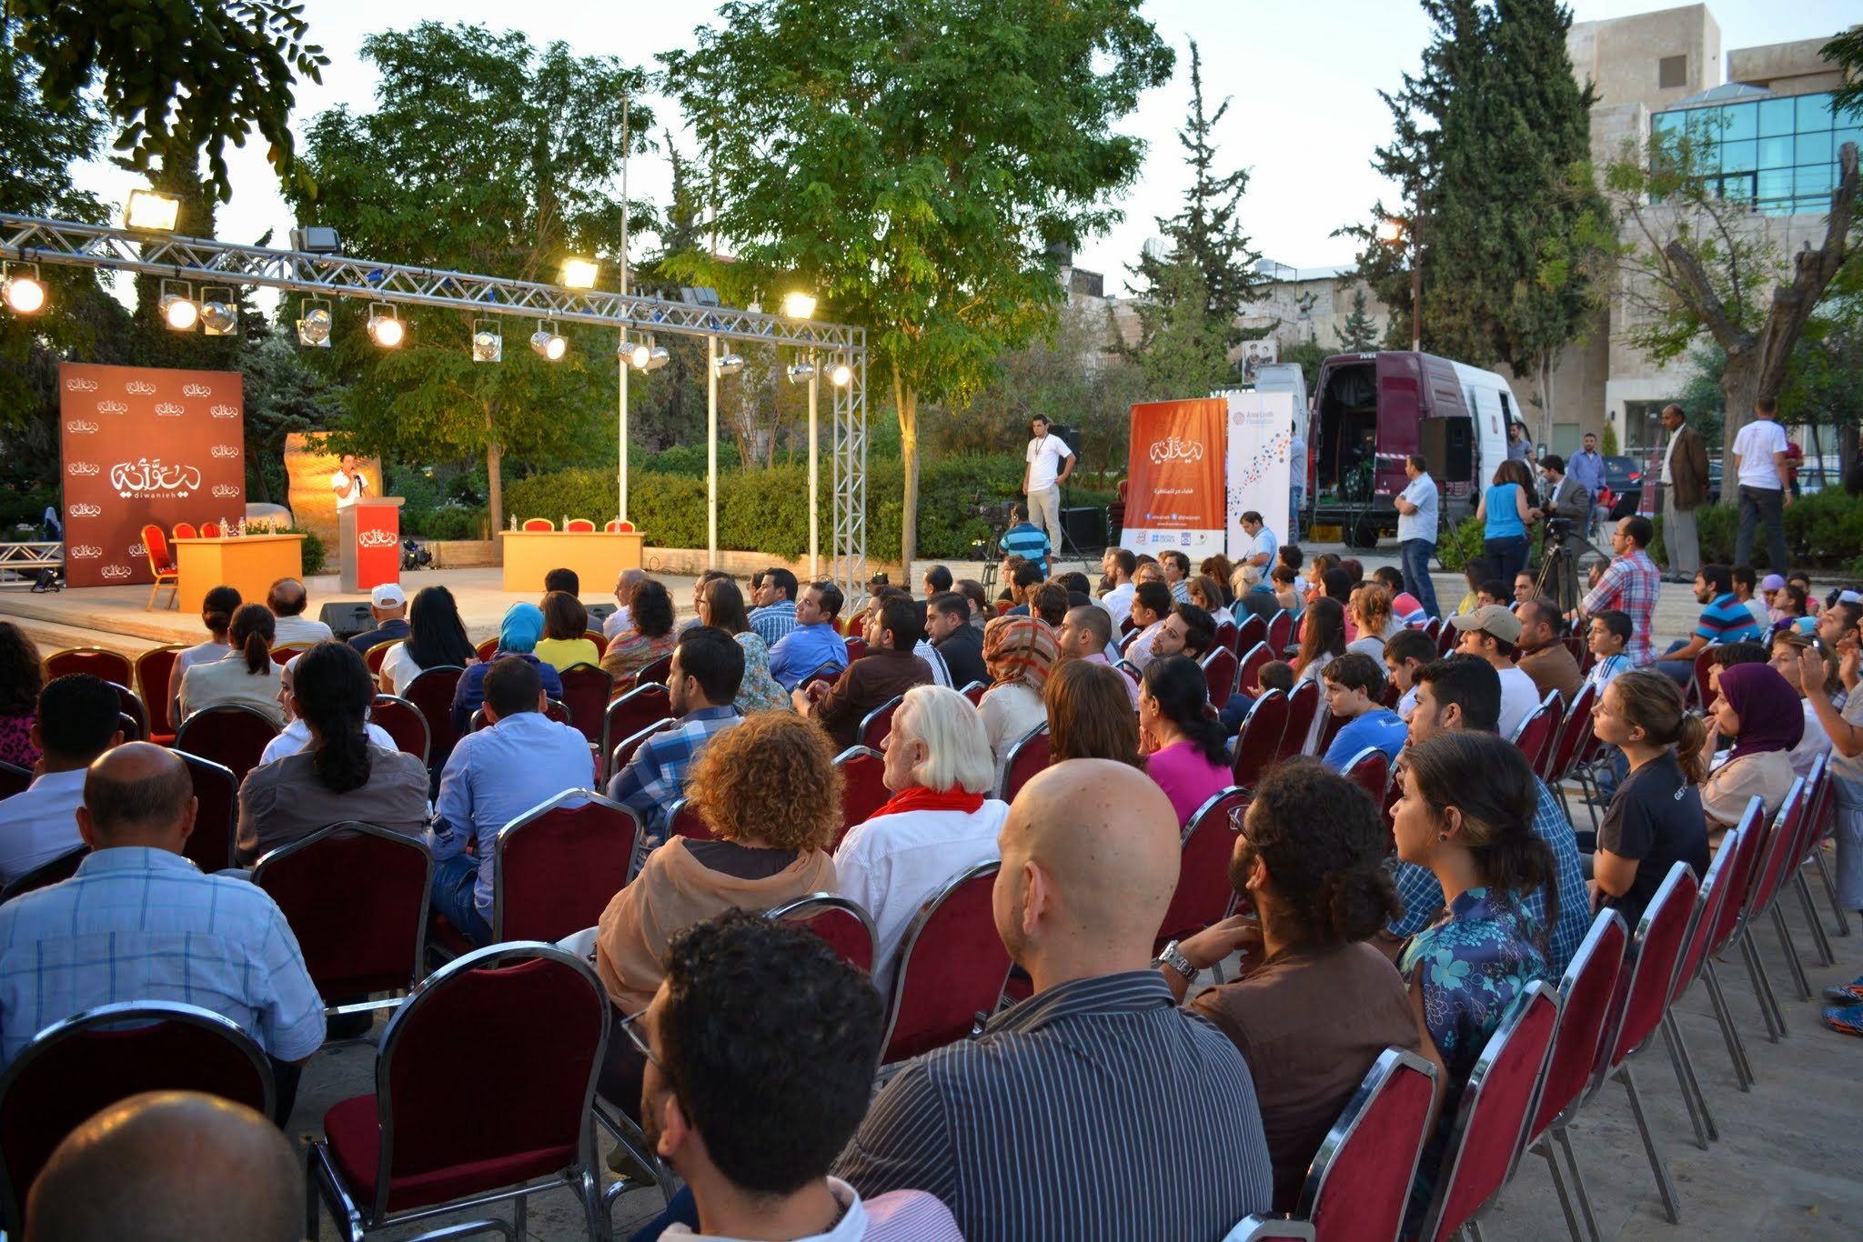

Slide 7
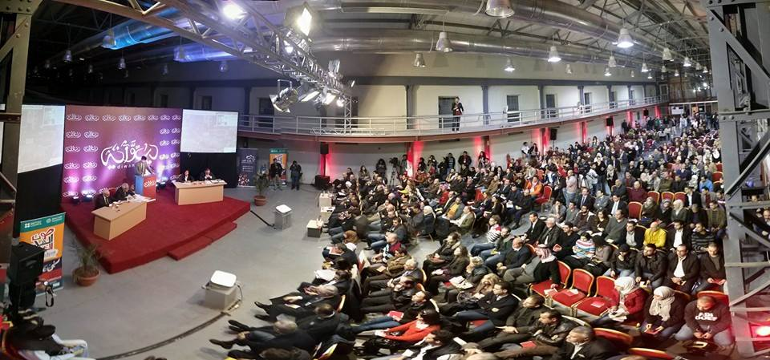

Slide 8
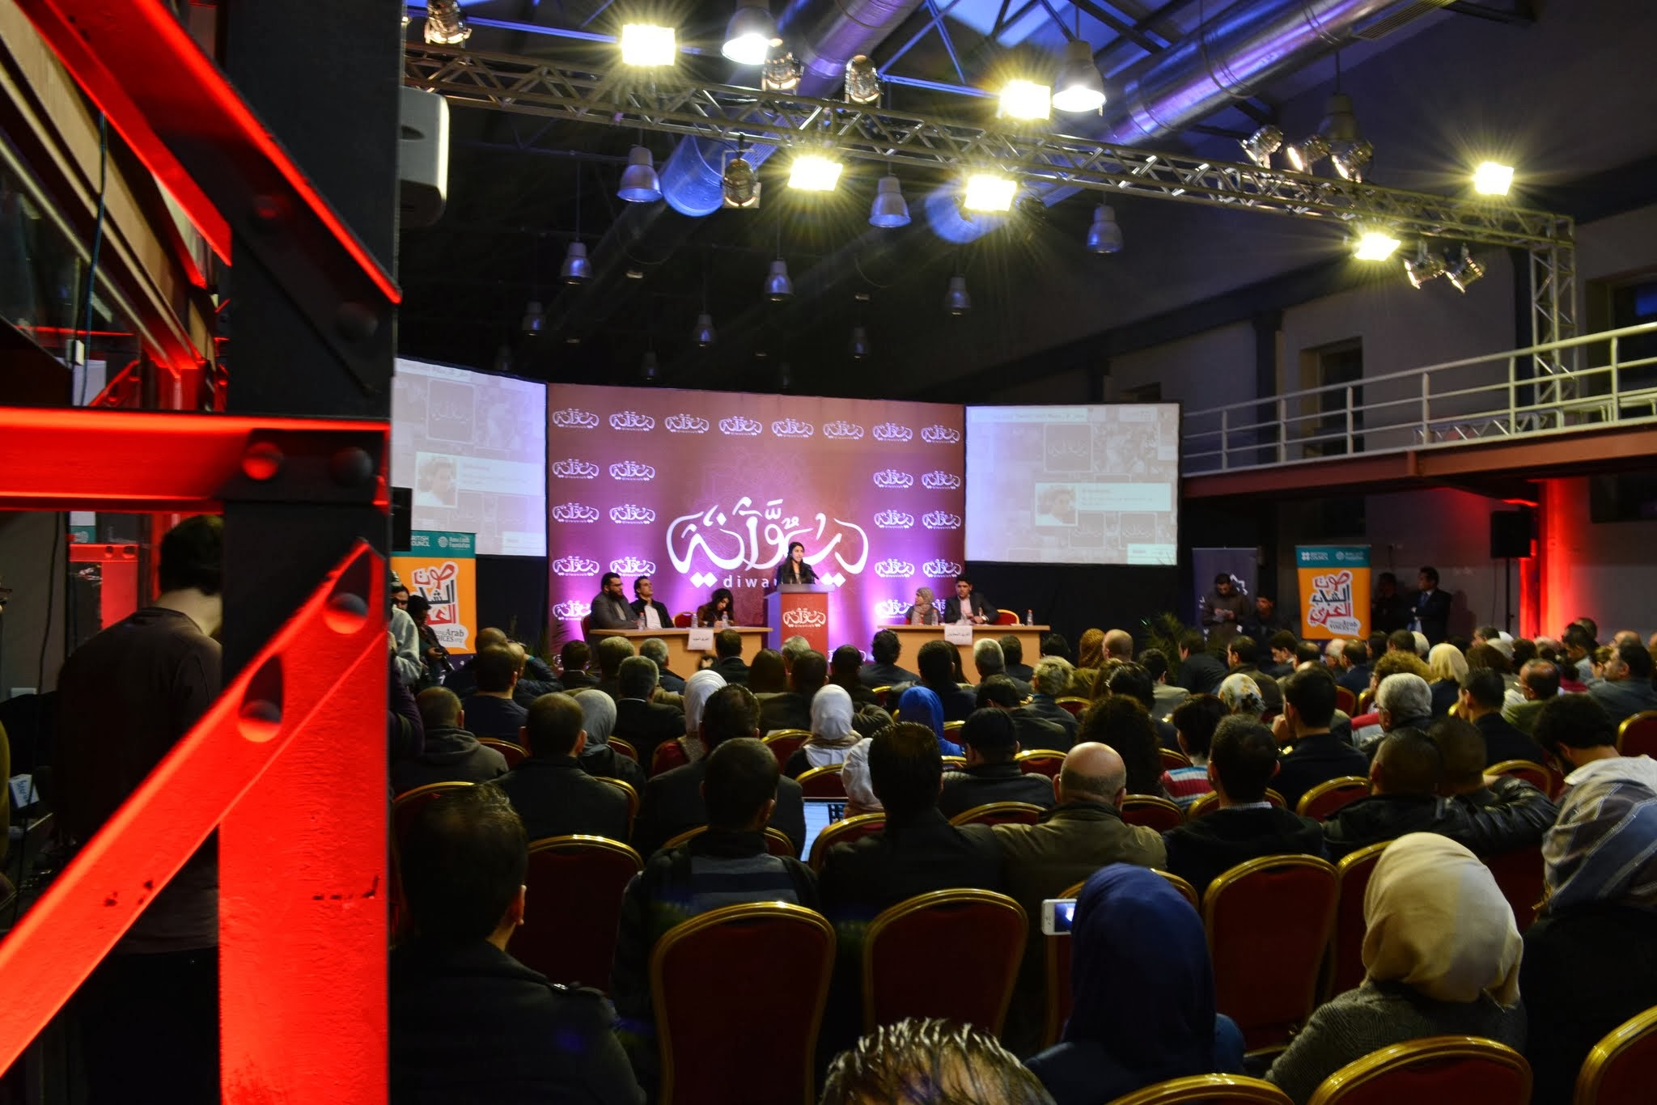

Slide 9
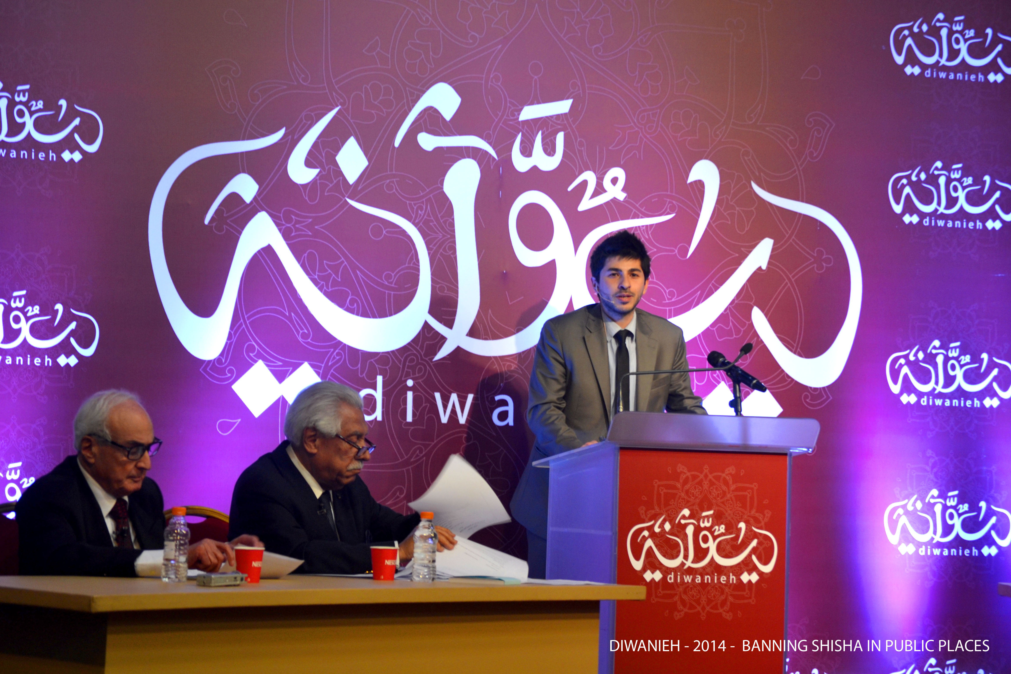

Slide 10
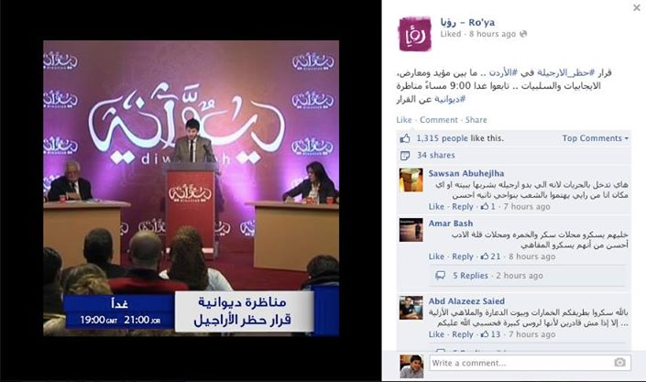

Slide 11
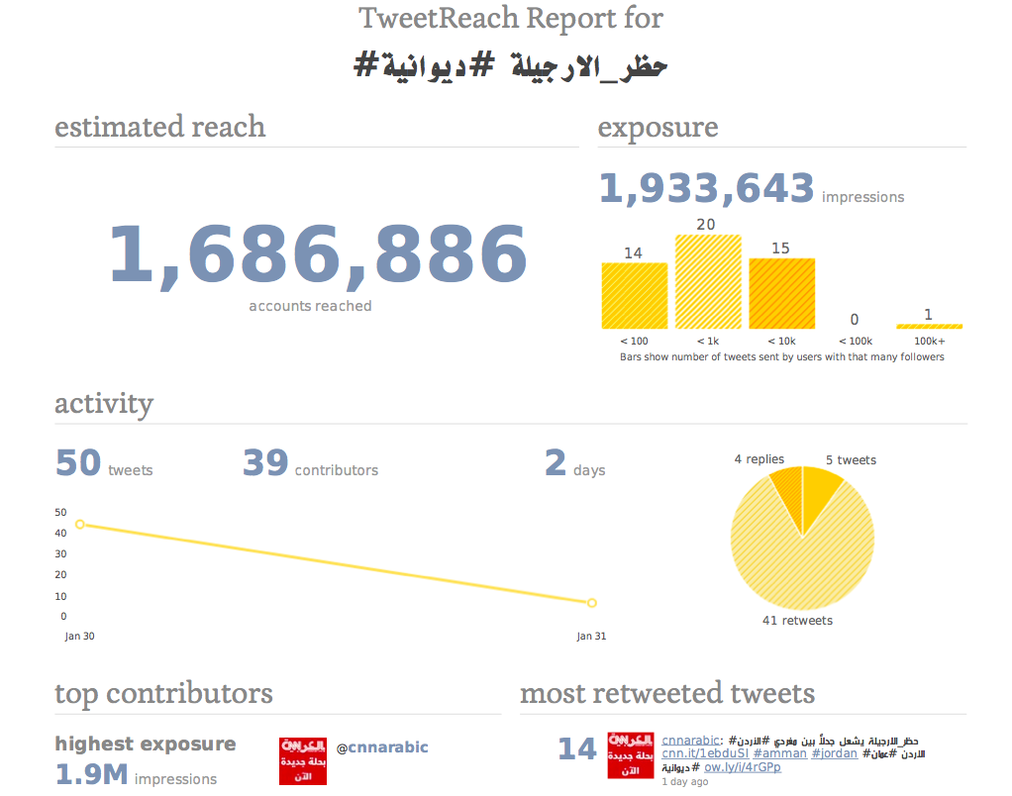

Slide 12
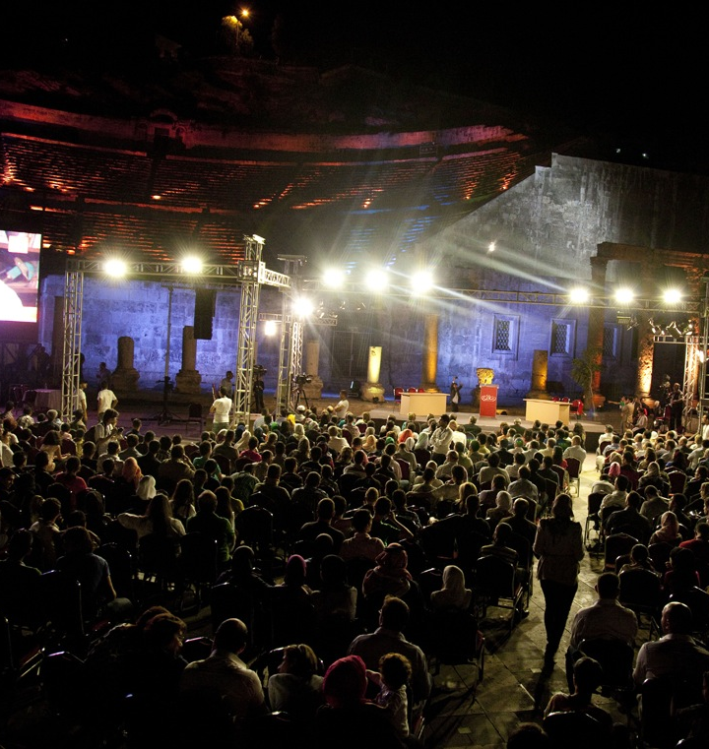
www.diwanieh.com

Slide 13
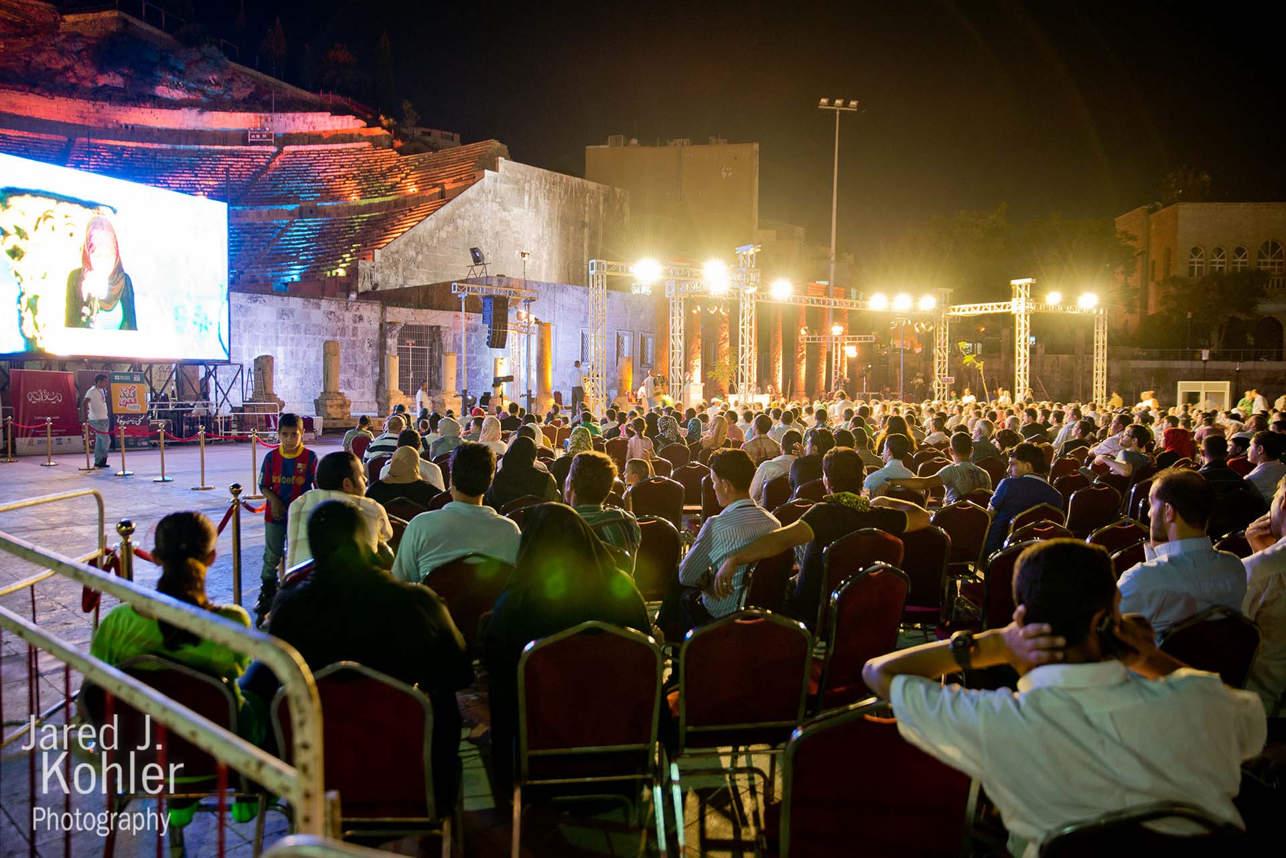

Slide 14
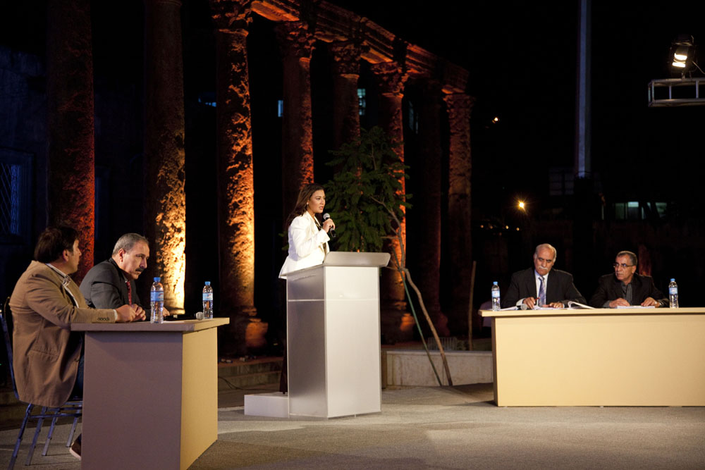

Slide 15
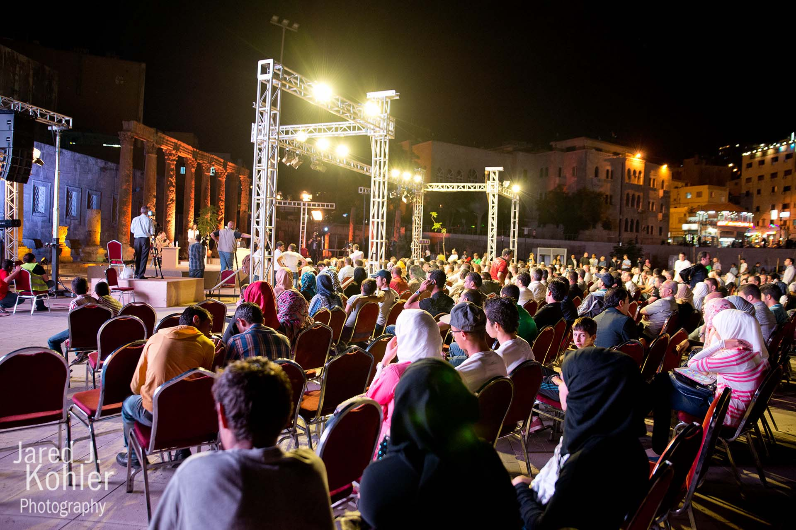

Slide 16
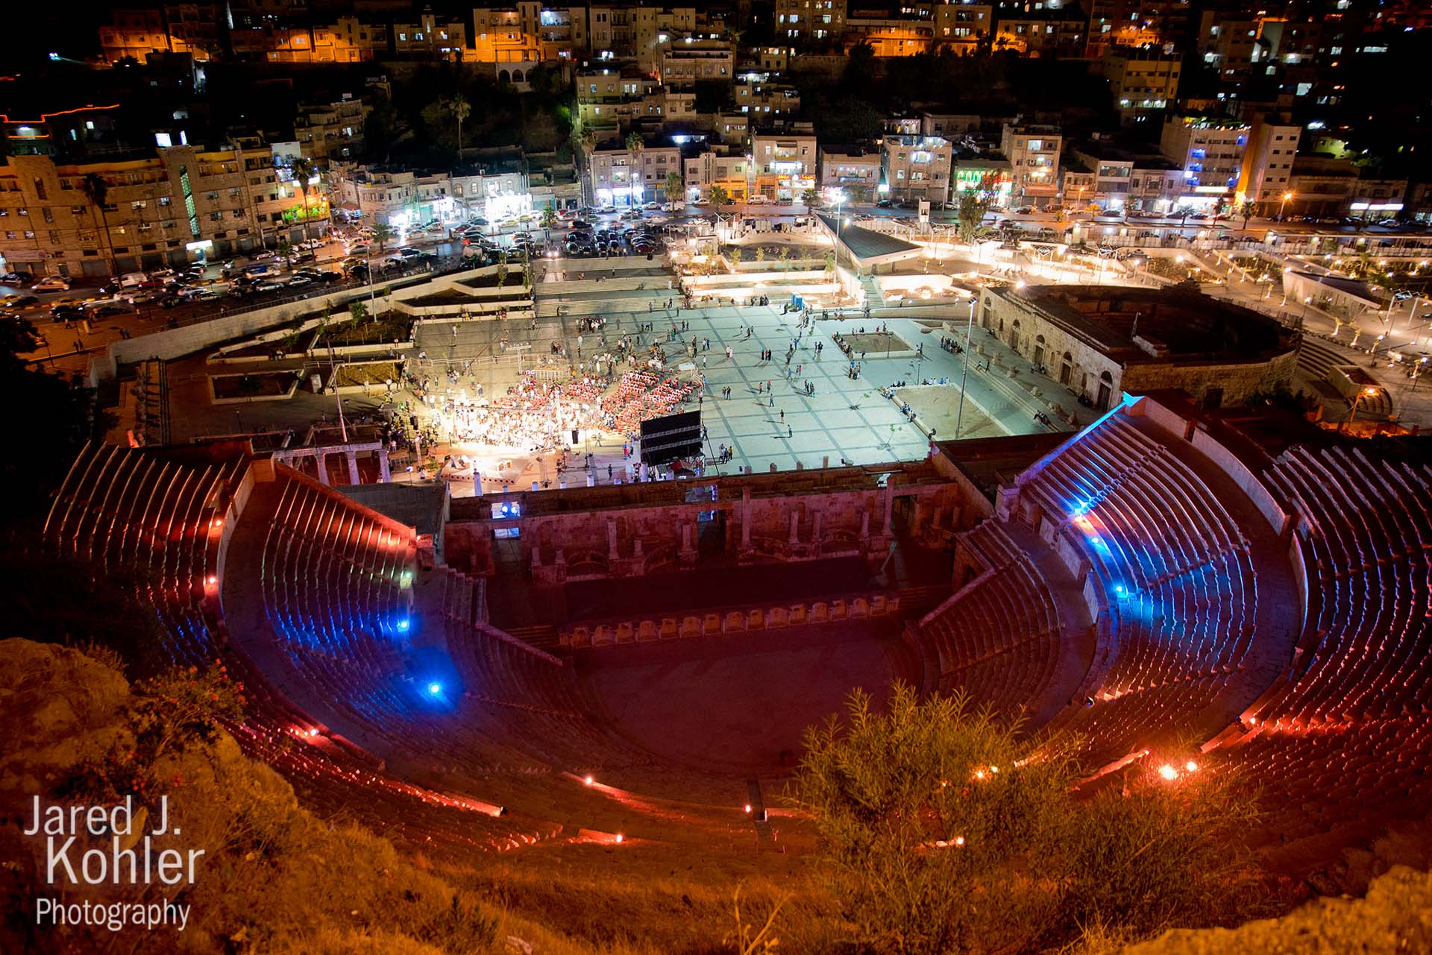

Slide 17
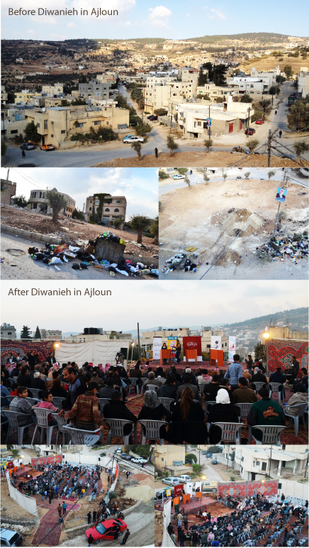

Slide 18
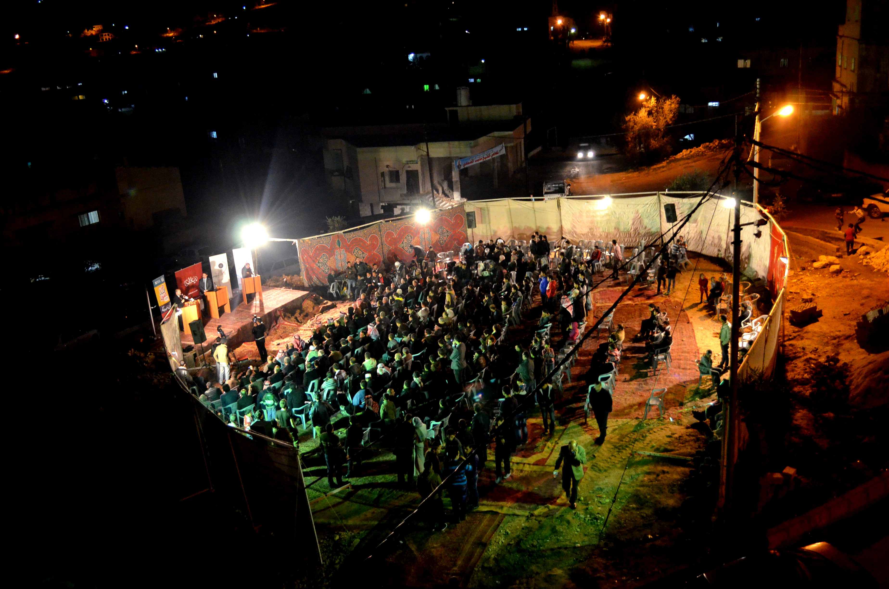
www.diwanieh.com

Slide 19
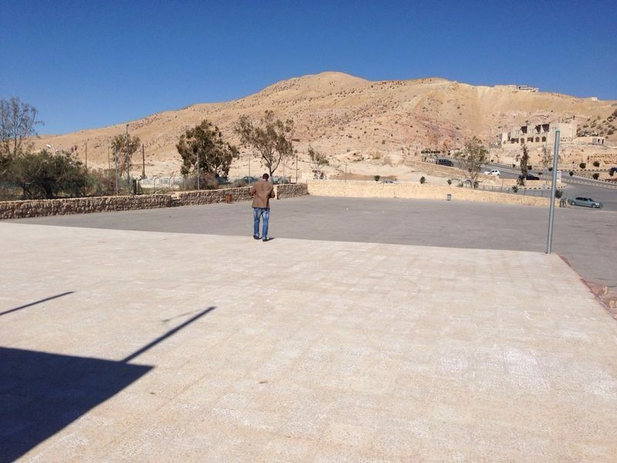

Slide 20
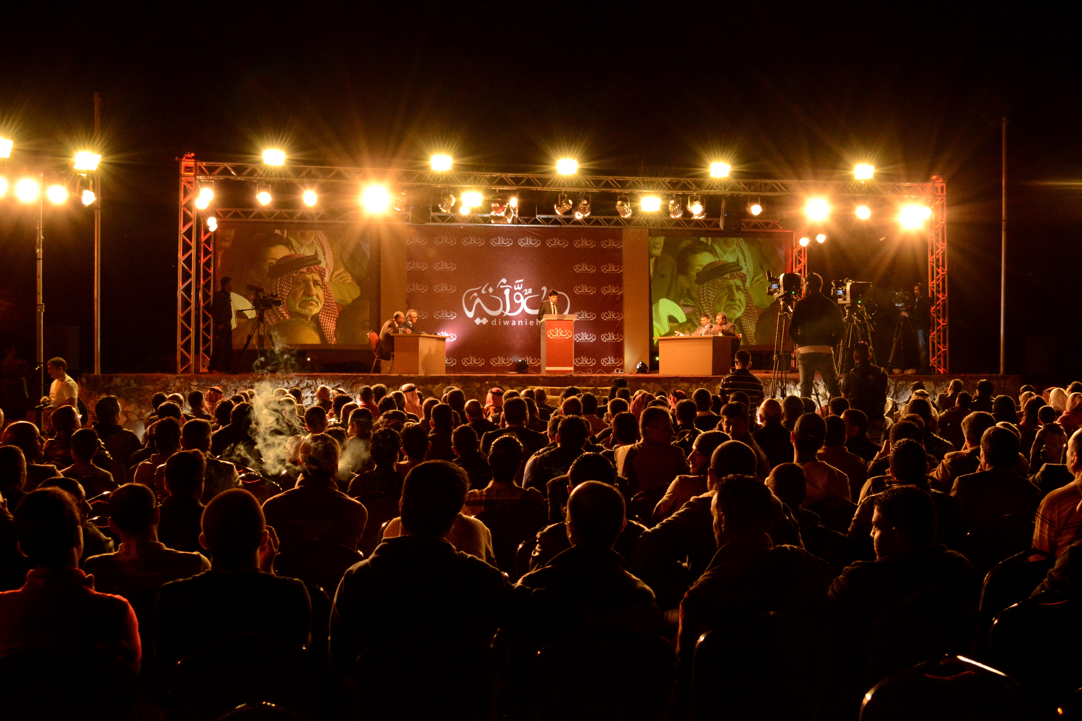
www.diwanieh.com

Slide 21
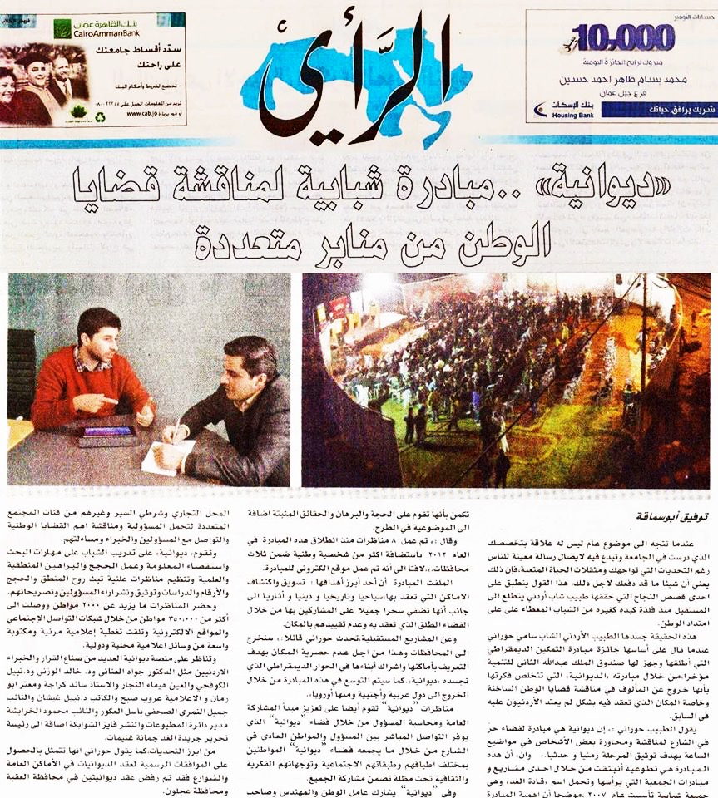

Slide 22
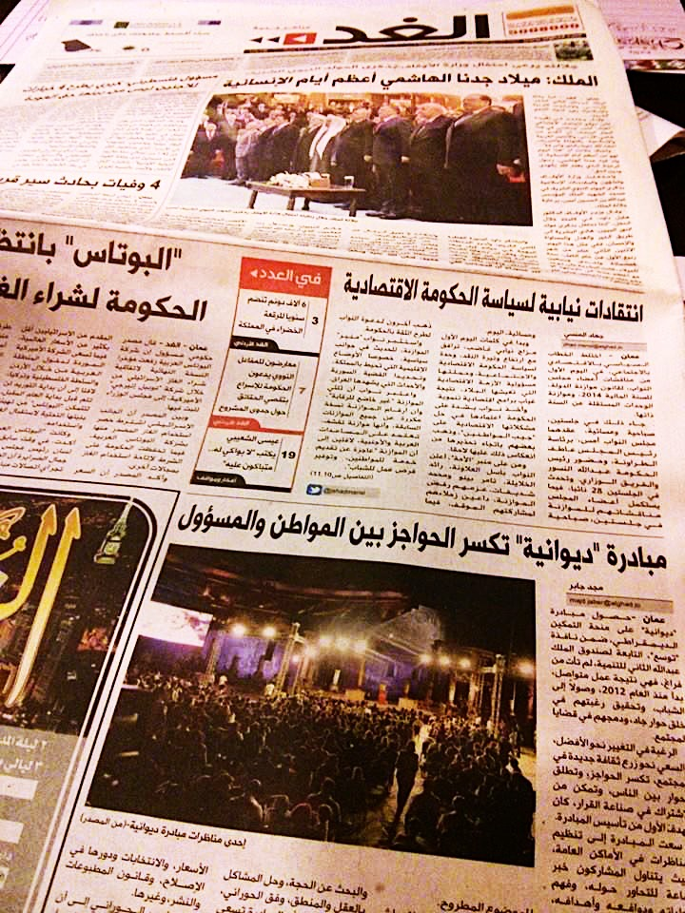

Slide 23

#FADFED
www.fadfed.org

Slide 24
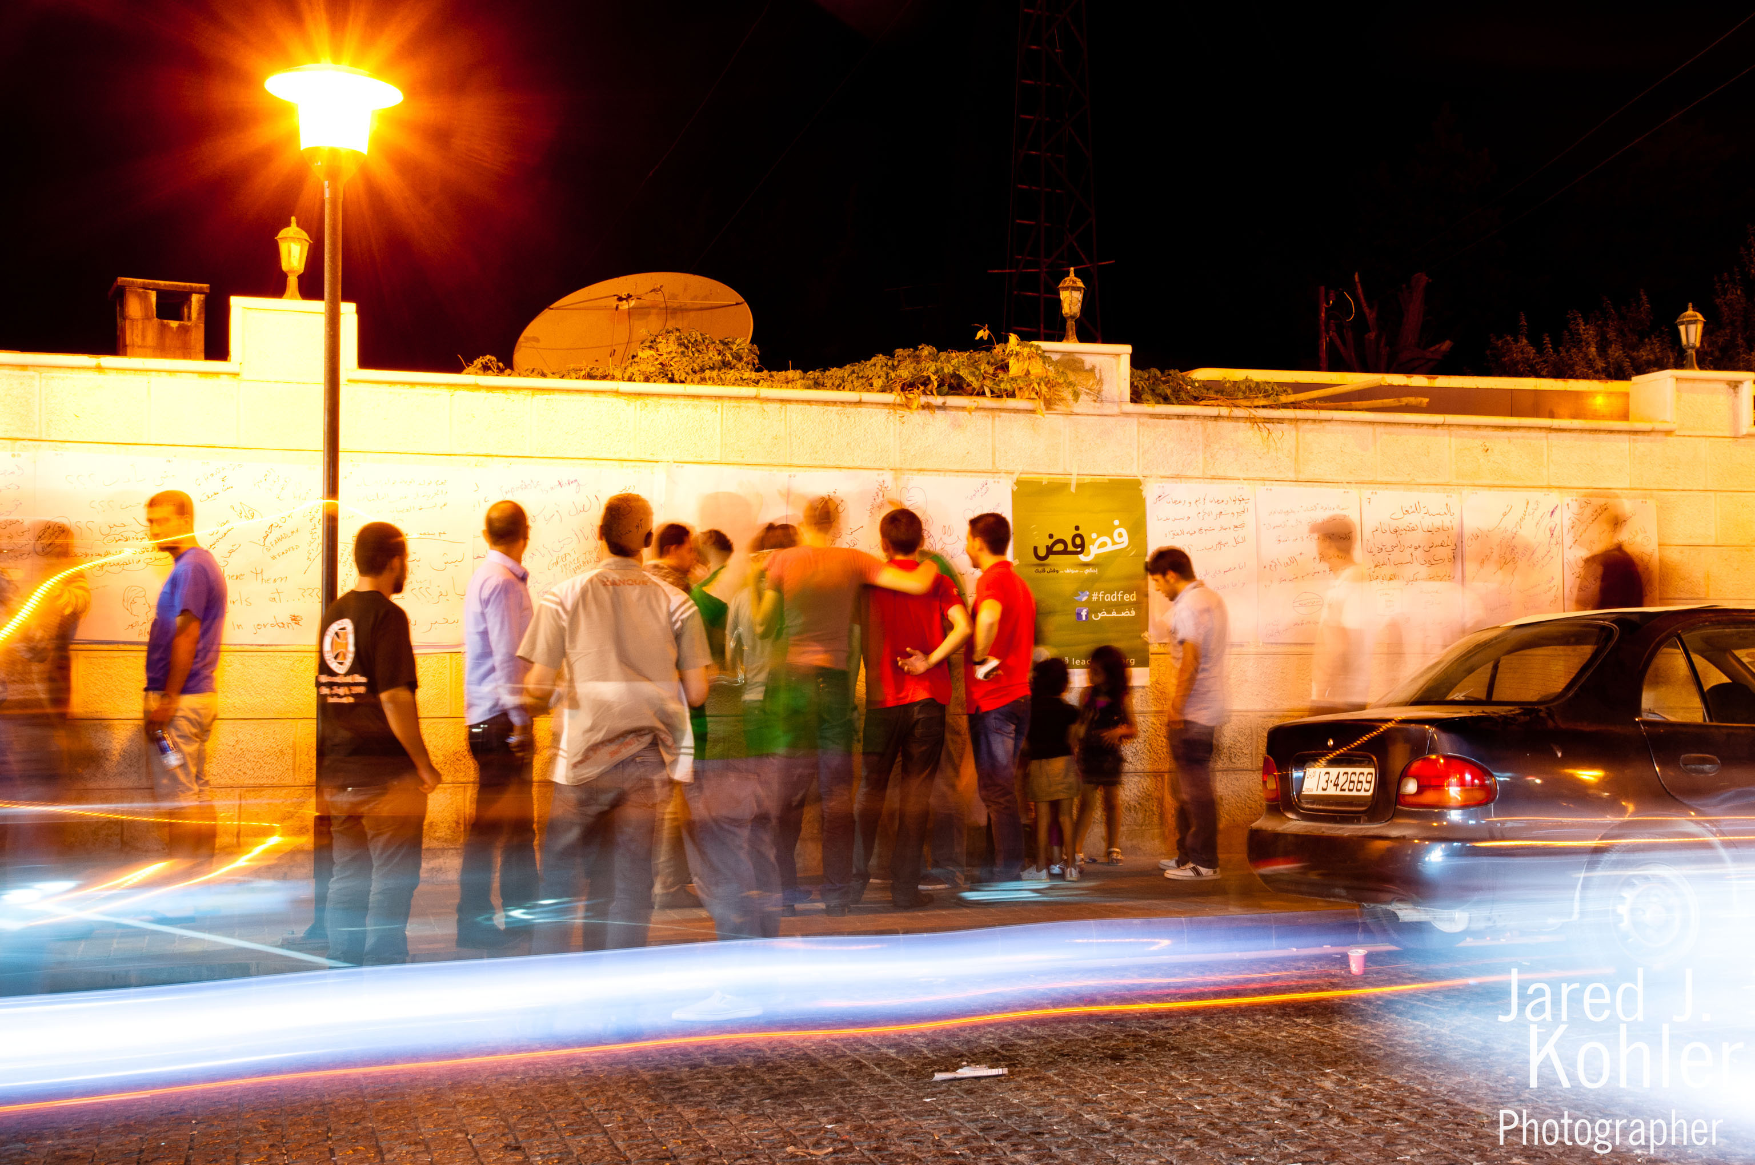
www.fadfed.org

Slide 25
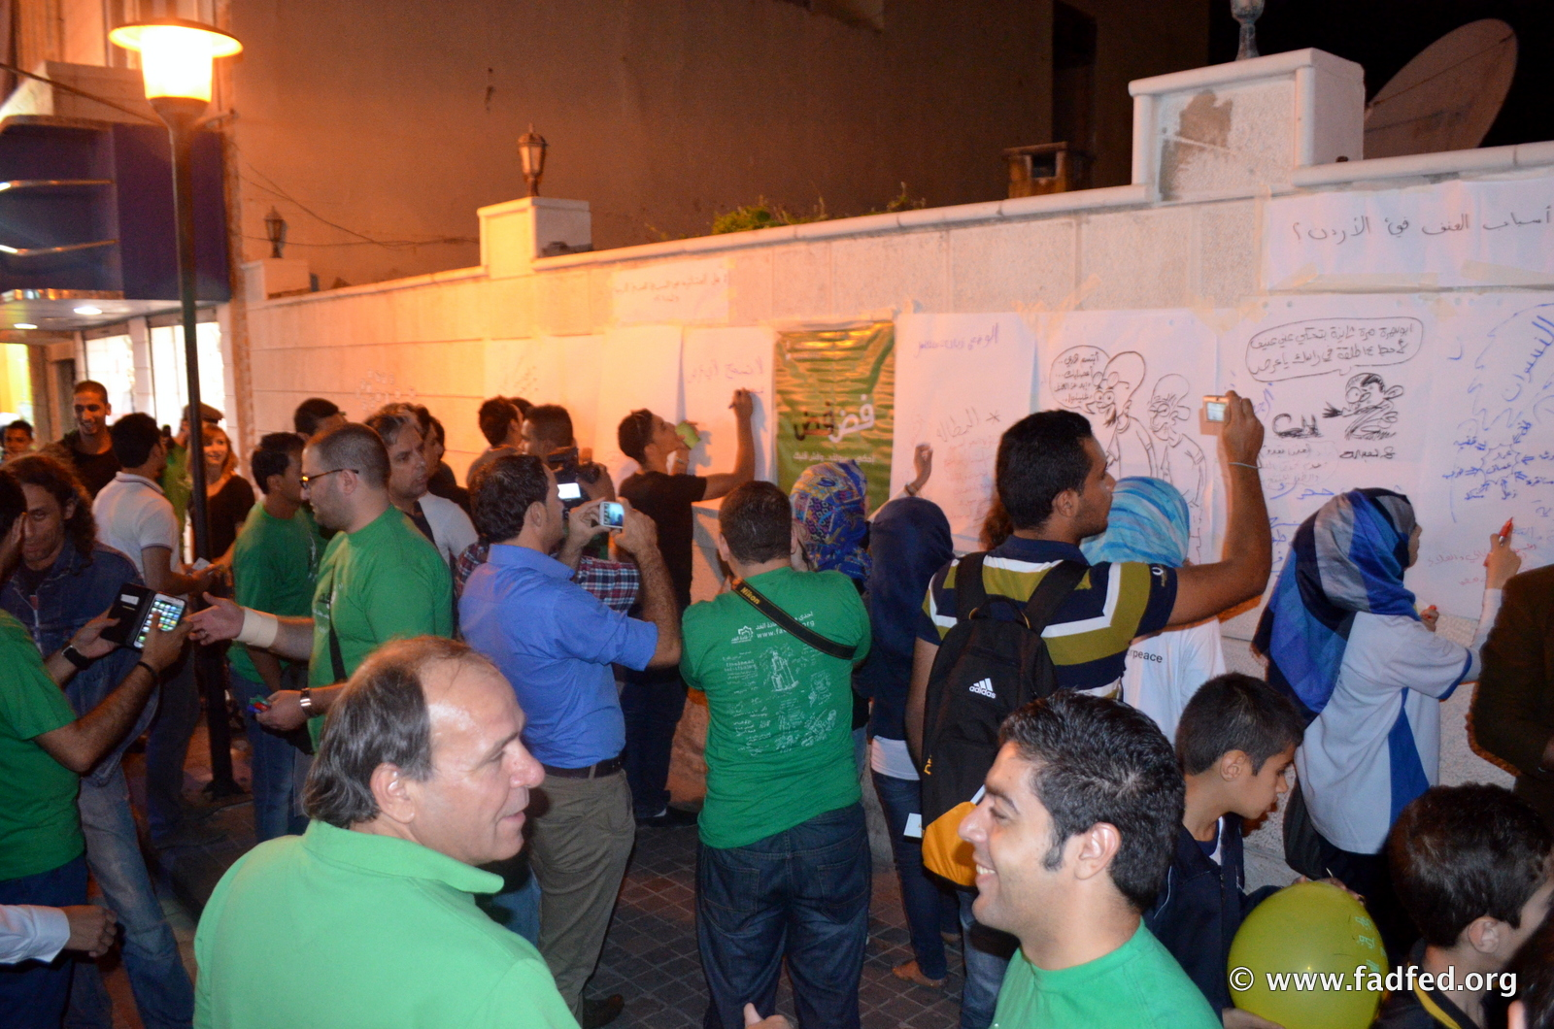

Slide 26
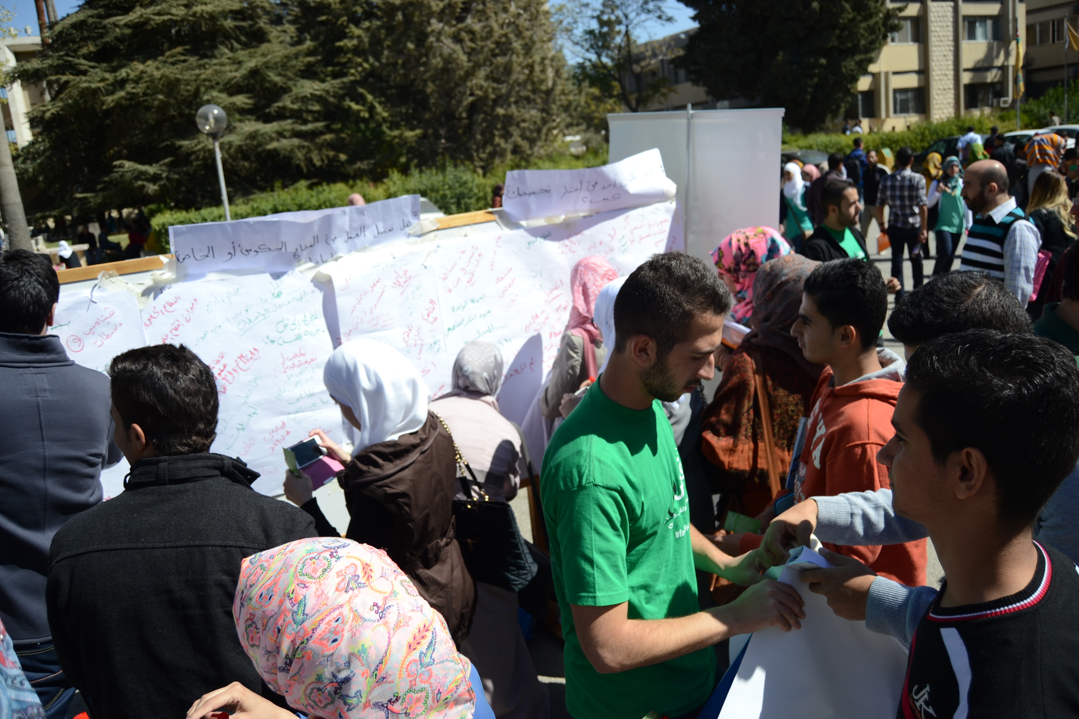

Slide 27
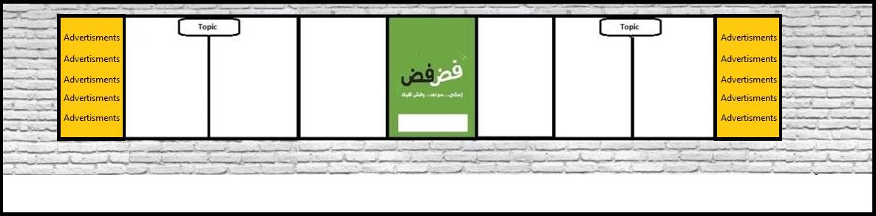
SHORT VIDEO: http://bit.ly/PJaMCg
Notes:
FADFED gathers during one event hundreds of genuine, uncensored and coded comments. In a short time we get a large sample size. All comments expressed are collected, logged into a database, and later on analyzed and interpreted to get the nuances, understand the emotions expressed and the implicit meanings of statements. As each written public statement is short and to the point, reading the logged answers of an event gives an immediate understanding of the public opinion on a mass scale that is written up in a report.
Change resides in the methodology three aspects:
Venue for freedom of expression
Tool for informal social accountability
Innovative research and public polling tool

Slide 28
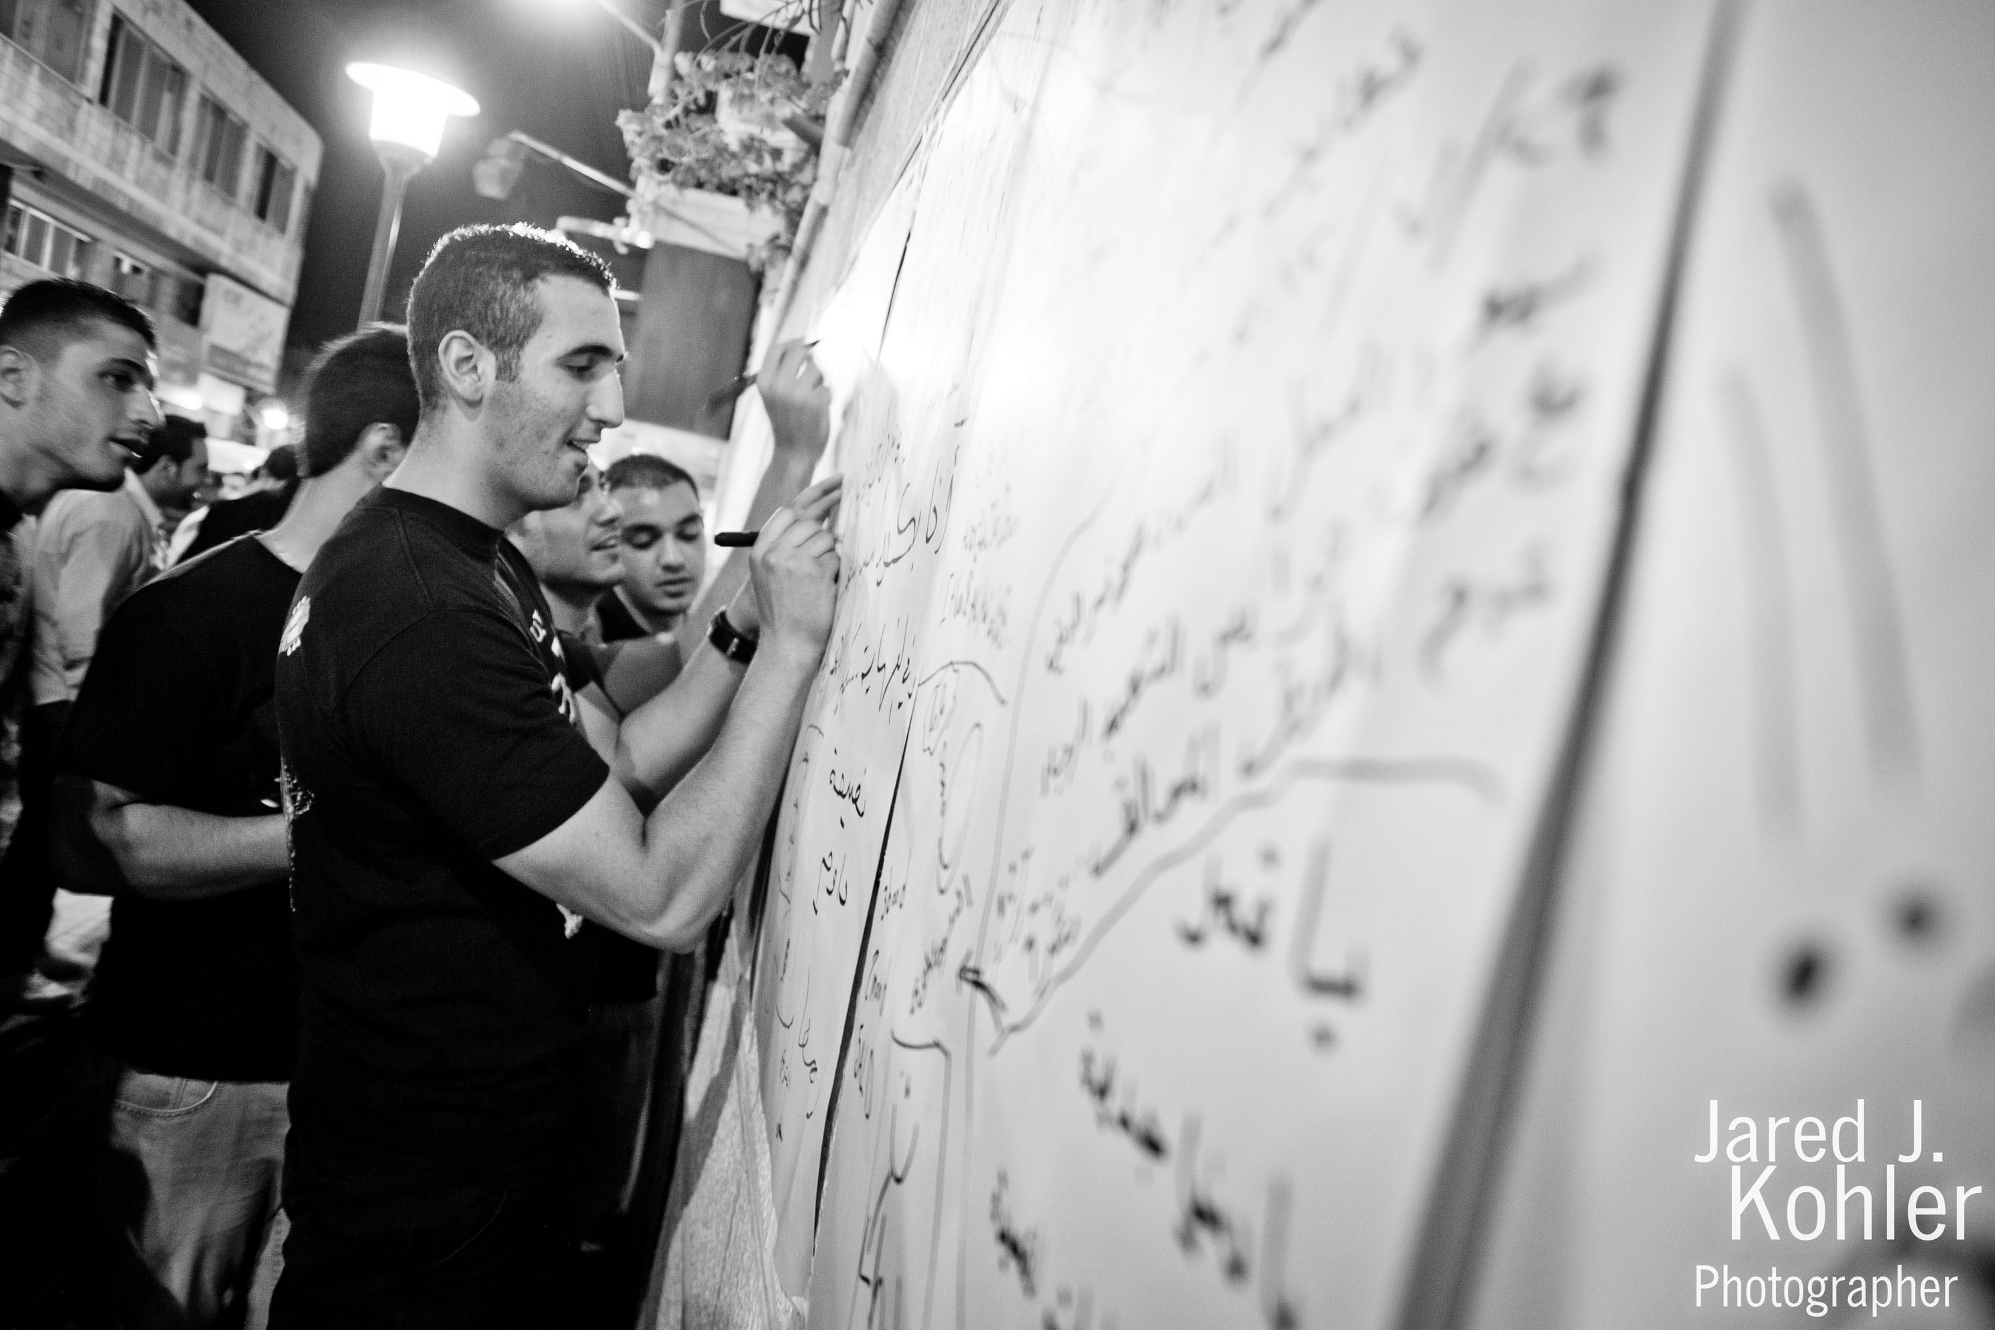
www.fadfed.org

Slide 29
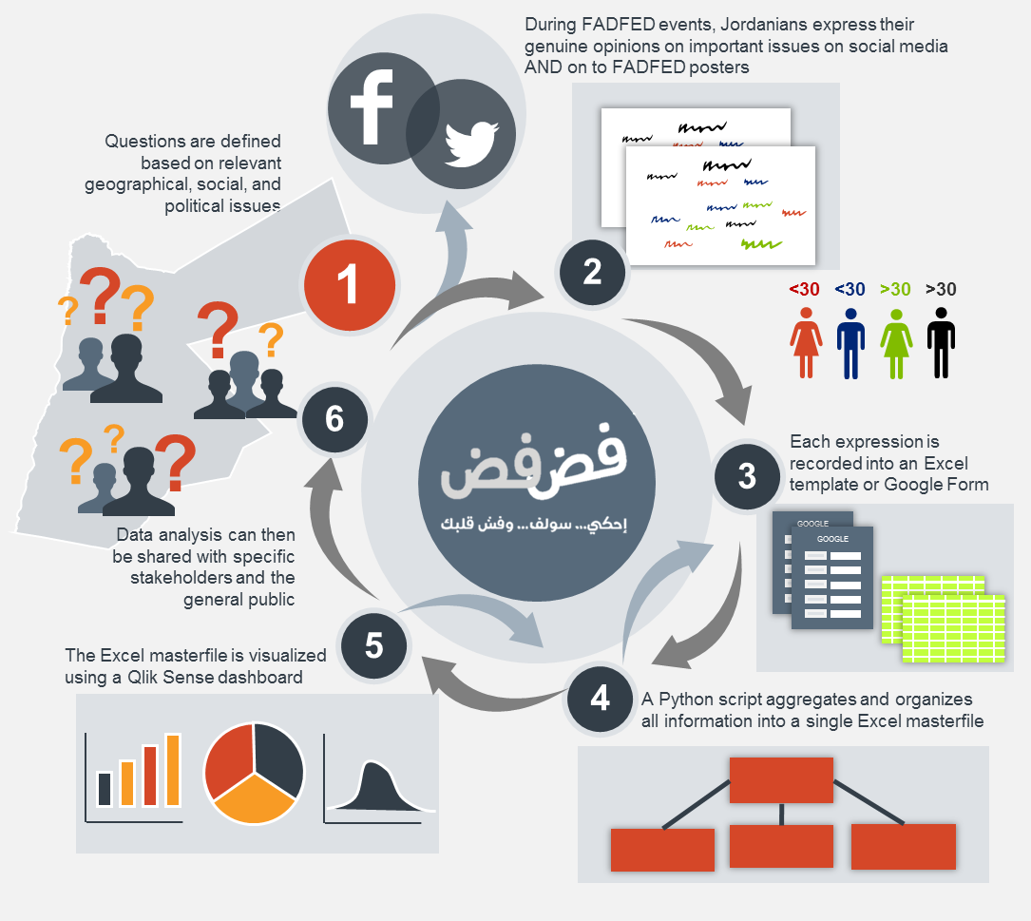

Slide 30
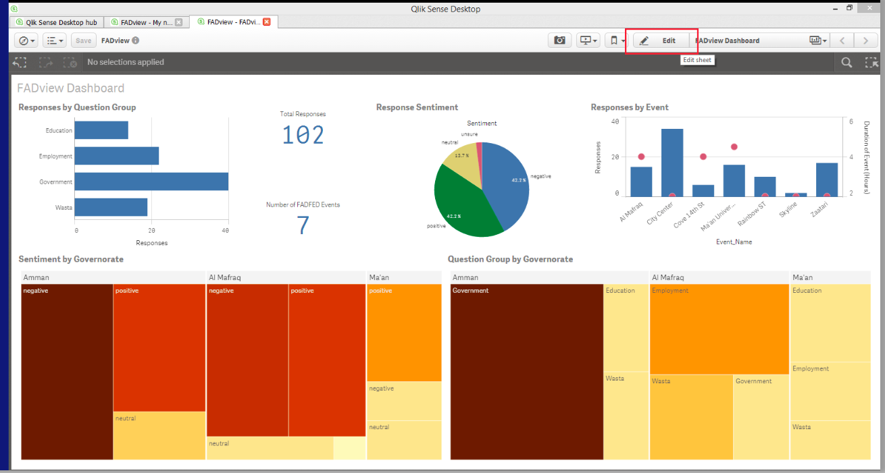

Slide 31
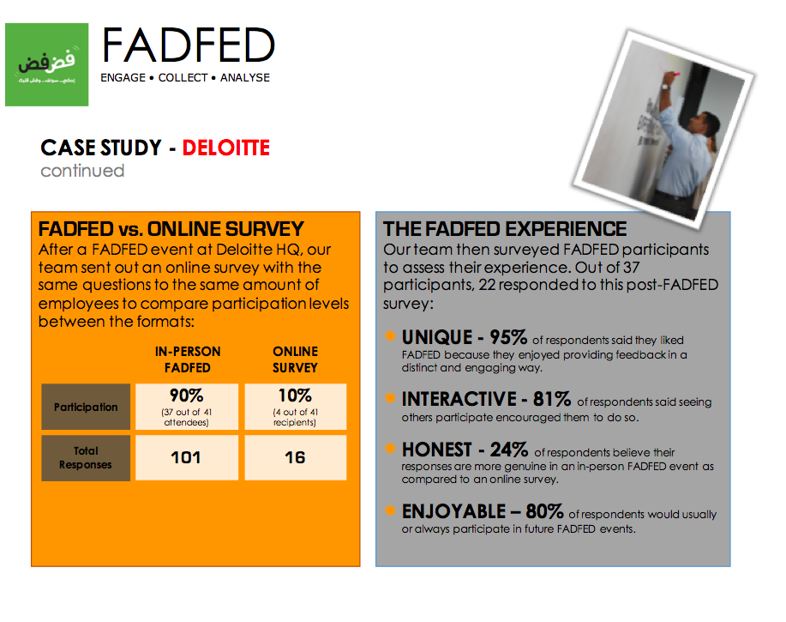

Slide 32
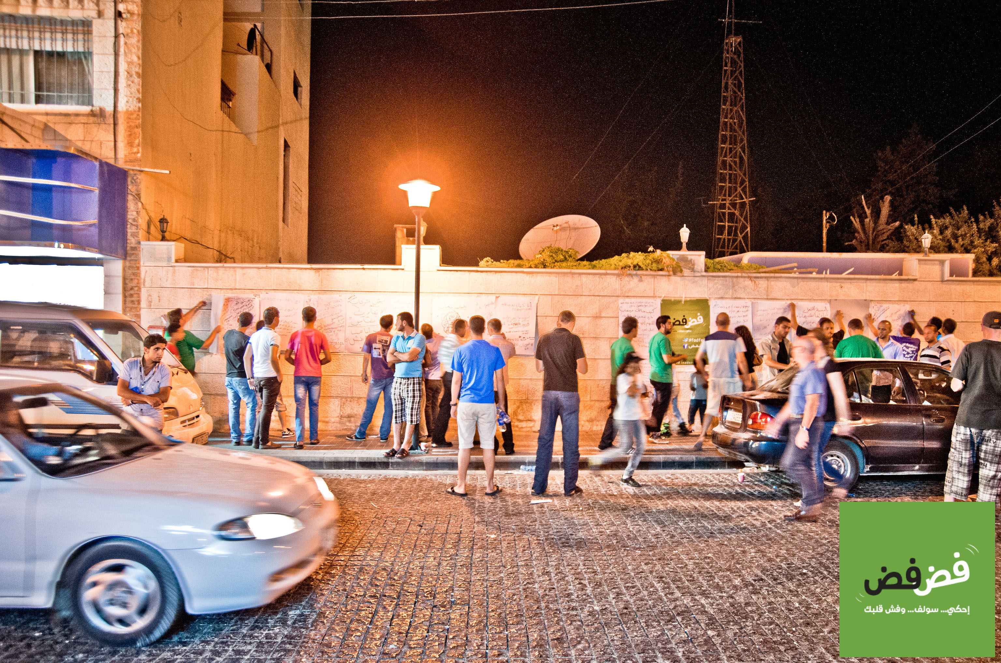

Slide 33
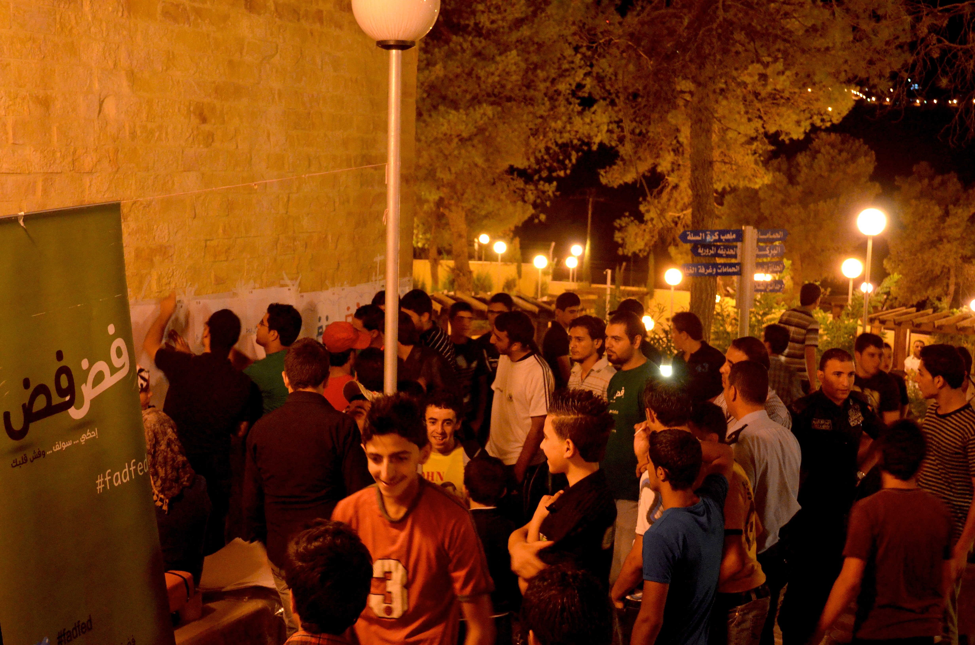
www.fadfed.org

Slide 34
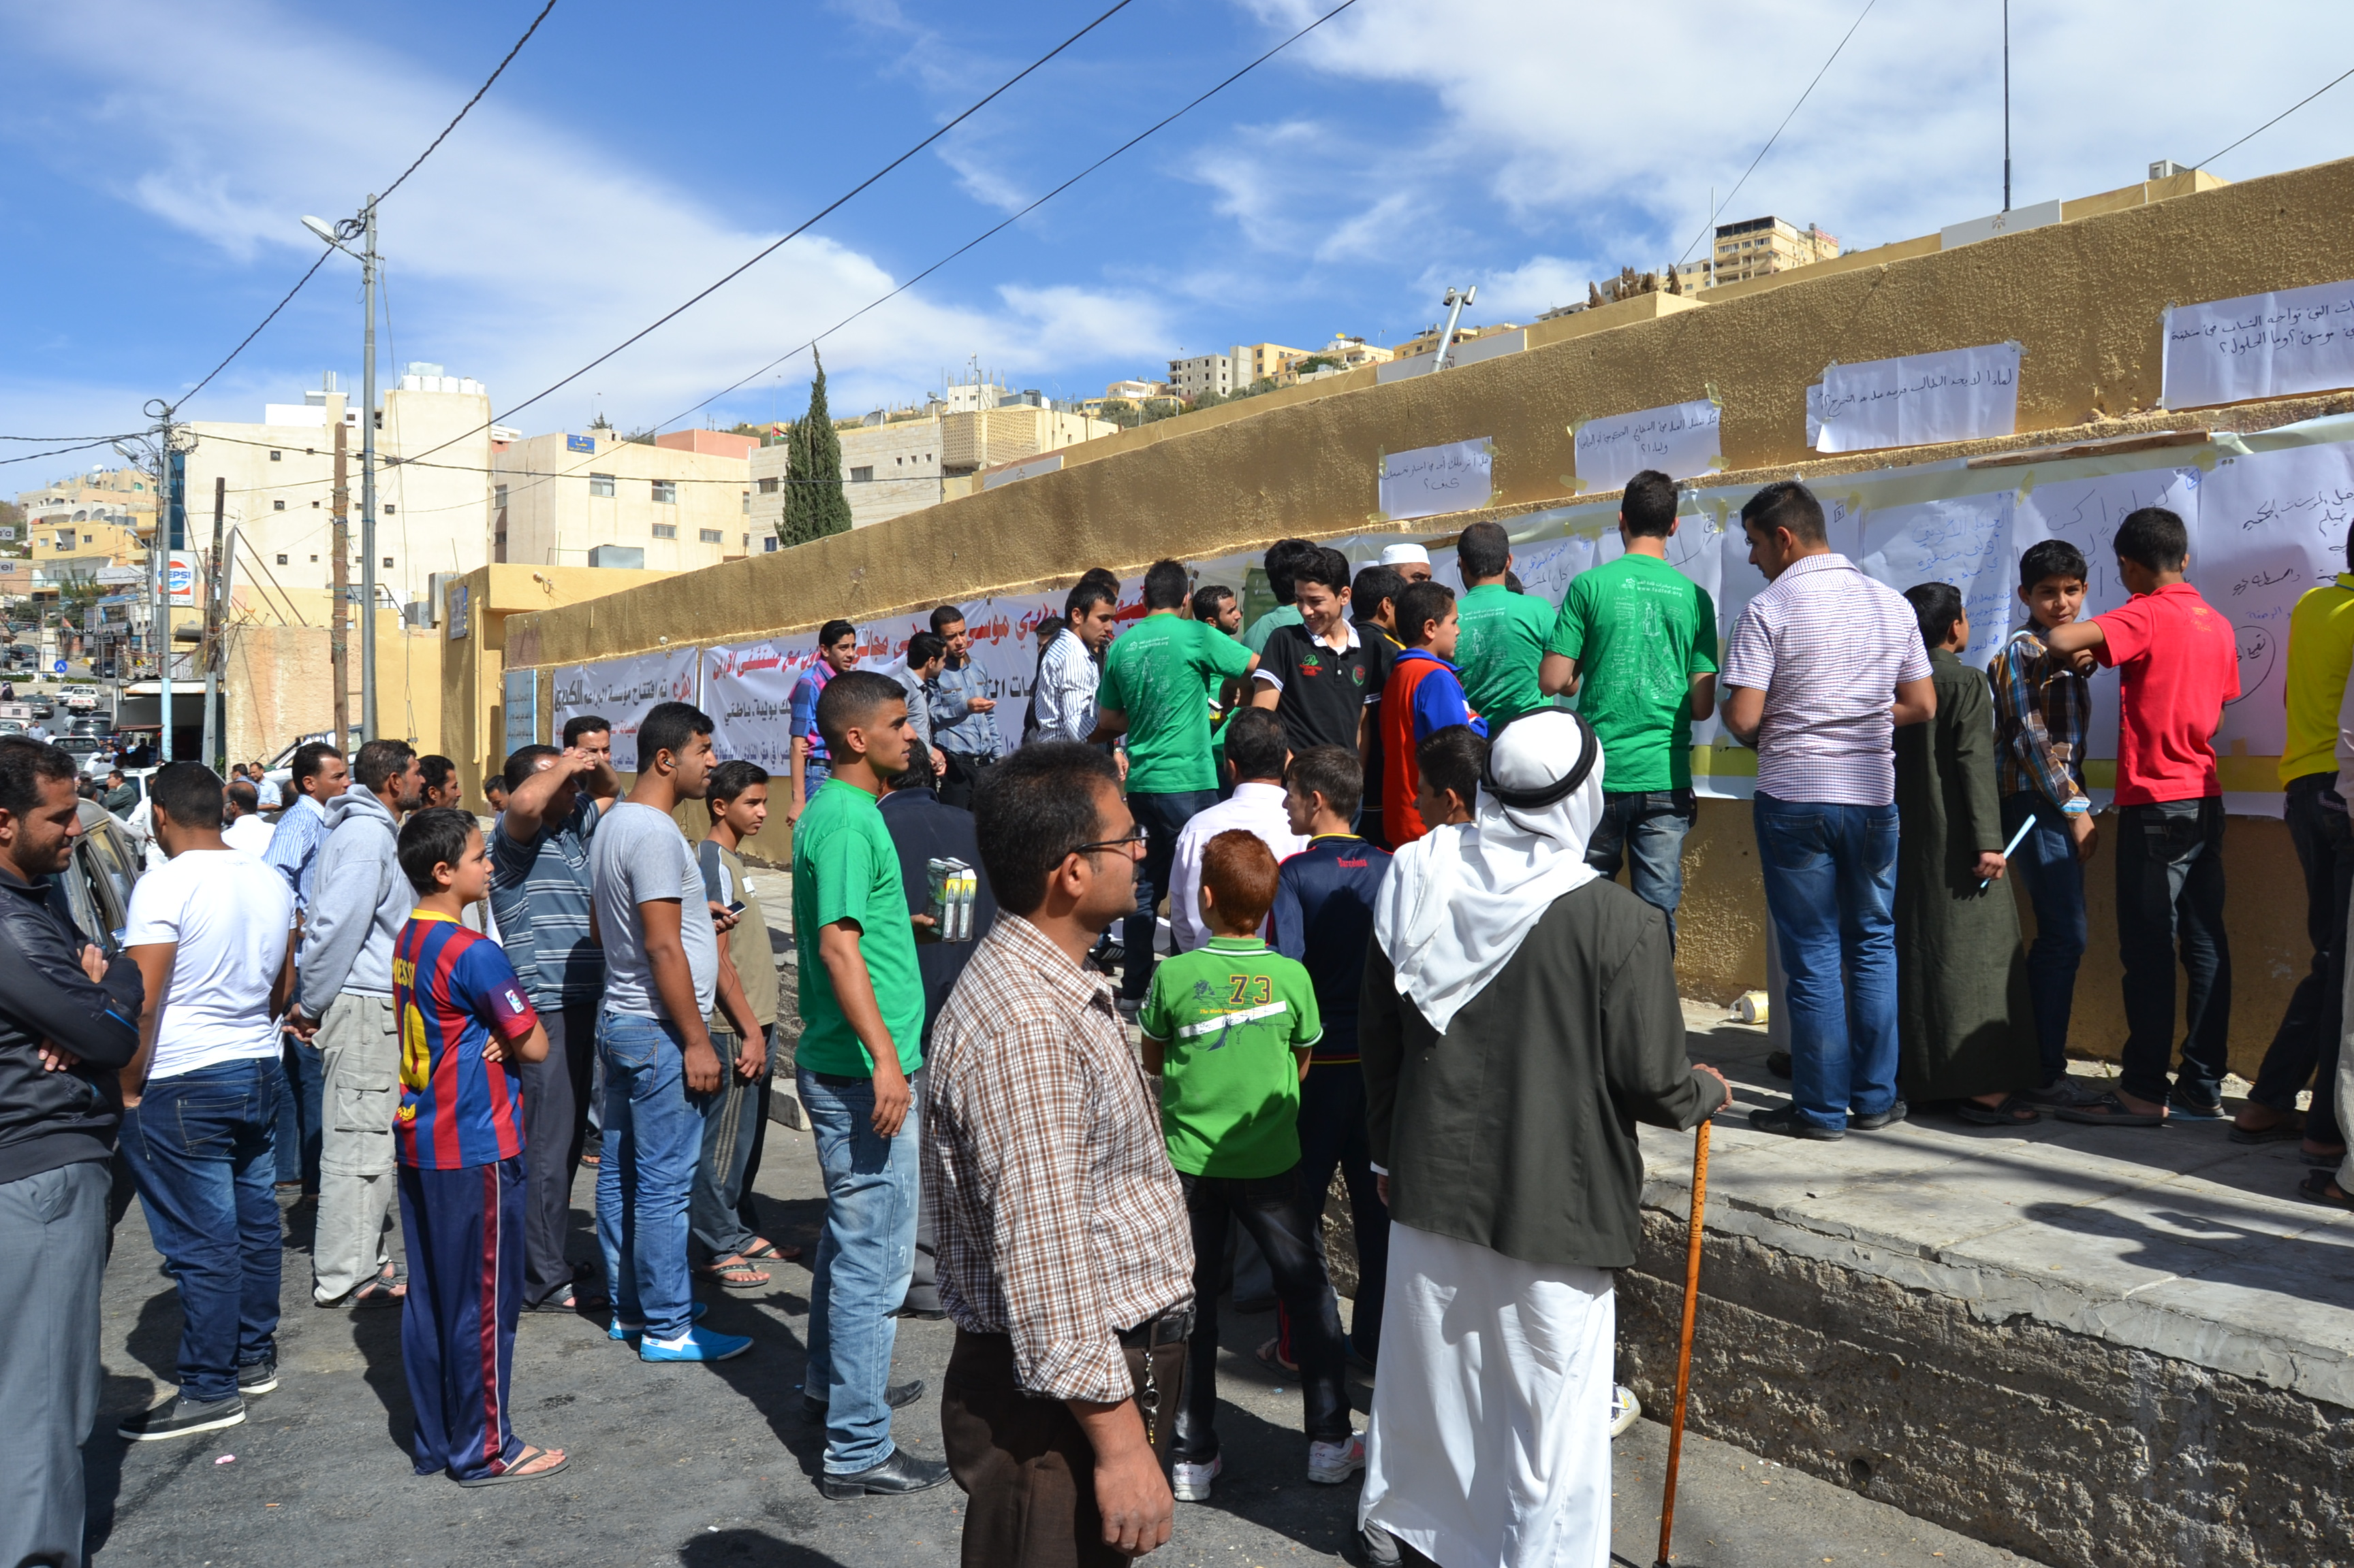

Slide 35


Slide 36


Slide 37
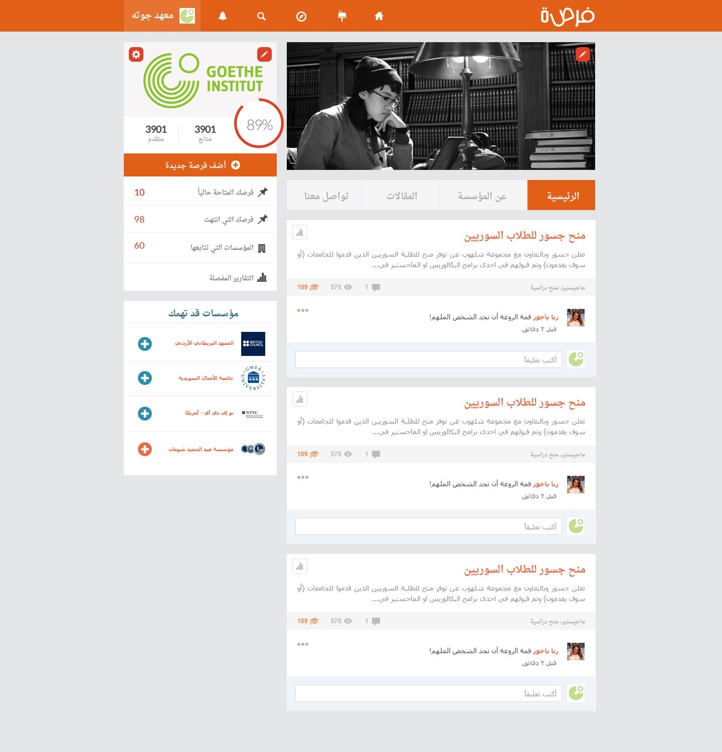

Slide 38
Stay in touch!
Follow on Twitter: @samihourani
Follow on Facebook: Sami Hourani
www.leadersot.org
Facebook: FB/leadersot
Twitter: @leadersot

Slide 39
Thank you

